Slide 1

AI FINANCE TECHNOLOGIES
Money-Wise
FINANCIAL FREEDOM, ONE SMART BUDGET AT A TIME!

Slide 2
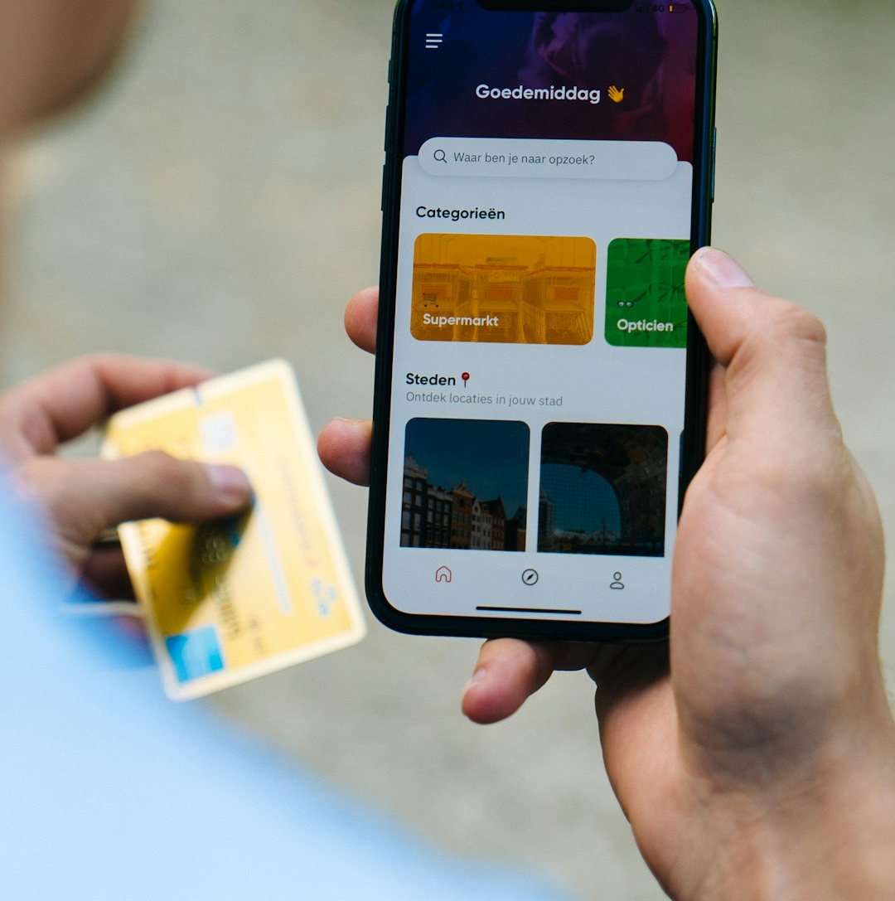
INTRODUCTION
App Overview
MANAGING PERSONAL FINANCES CAN BE CHALLENGING.
Handling multiple transactions, savings goals, and expenses can be overwhelming.
The AI-Based Personal Budget Manager simplifies financial management through AI and automation.
Designed for everyone: Students, Professionals, and Businesses.
TAKE CONTROL OF YOUR FINANCES WITH AI-POWERED EFFICIENCY!

Slide 3
JUSTIFICATION
Financial literacy and management are crucial in today's economy. Many individuals struggle with:
Overspending
Poor savings Habits
Disorganized financial records
This project seeks to address these challenges by providing a smart, automated solution that:

Slide 4




Key Features
MPESA INTEGRATION:
AUTOMATED EXPENSE TRACKING:
GOAL-BASED SAVING:
REAL-TIME FINANCIAL INSIGHTS:
Monitor and access mobile transactions in one place.
Set and track savings objectives effortlessly.
AI categorizes transactions seamlessly.
Instant reports, alerts and analytics for better decision-making.

Slide 5


AI Capabilities
AI API INTEGRATION FOR CATEGORIZATION
NLP CHATBOT FOR FINANCIAL GUIDANCE
Enables Mpesa message breakdown
Provides insights on how to improve spending habits.
Answers financial queries and suggests budgeting strategies in real time.

Slide 6

COMPETITIVE ADVANTAGE
Why We Stand Out
Beyond Existing Apps: Mint, YNAB, and other budgeting tools
Real-time AI-driven financial insights.
Seamless M-Pesa Integration for easy transaction tracking.
Smart AI-Powered Categorization for accuracy.
What Makes Us Unique?
NLP Chatbot for personalized financial guidance.
Automated Smart Budgeting tailored to spending habits.
Secure & User-Friendly interface.

Slide 7

MONETIZATION STRATEGY
Financial Growth Overview
Revenue models for sustaining app development and growth
Patnerships with
Financial institutions
One Time Purchase &
Subscription models
Freemium Model

Slide 8
Roadmap
Jan
Feb
Mar
Apr
Problem Identification
Development
Deployment
Design
Testing

Slide 9
CALL TO ACTION
Financial Freedom, One Smart Budget at a Time!

